Slide 1
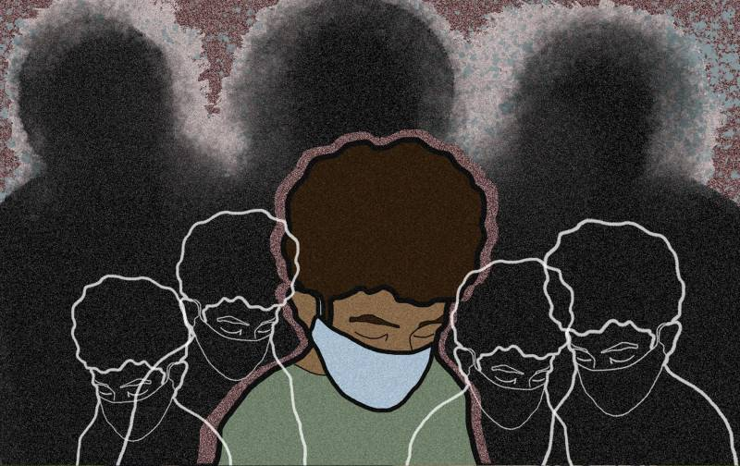
National Level Hate Crime Count
By: Ayesha & Anusha

Slide 2
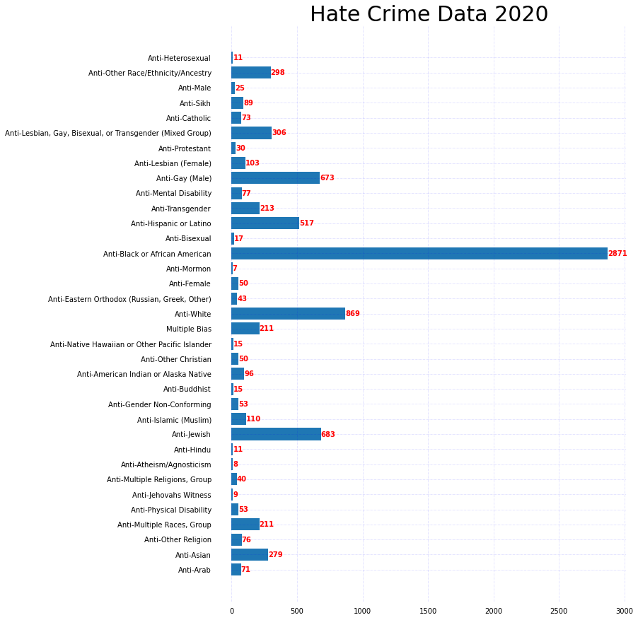

“Misunderstanding arising from ignorance breeds fear, and fear remains the greatest enemy of peace.” – Lester B. Pearson

Slide 3
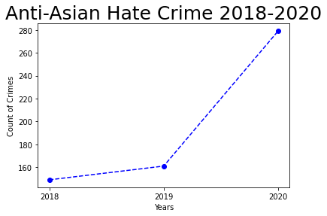
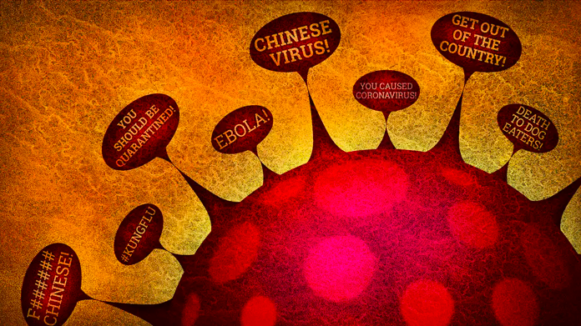

Slide 4
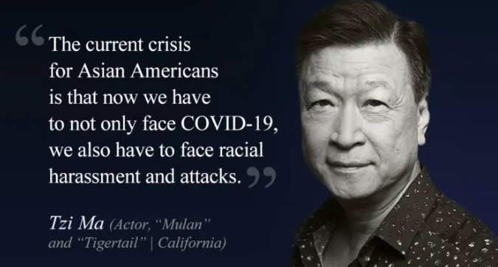
Factors that Influence the Spike (Anti-Asian)
Average count (2018-2020): 196
Anti-Asian hate crimes rose 73% from 2019 to 2020
COVID: end of 2019
Political climate: “Chinese Virus”
White people made up more than 55 percent of the offenders across the board.

Slide 5
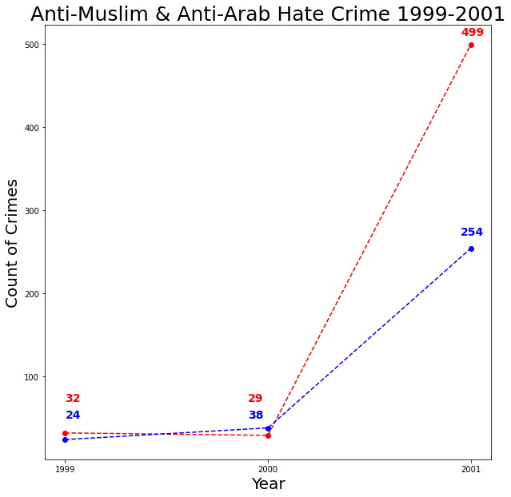
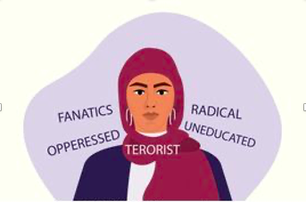
“My faith was viewed as a curiosity not a threat but that morning things changed.”
-Farhana Khera

Slide 6
Factors that Influence the Spike (Anti-Muslim)
Misconceptions
Fear
Mistaken Identity: some were for being perceived as Muslim
Types of crimes in the weeks following 9/11: Mosques were burned, death threats and harassment
Hate crimes against Muslims rose 1620%
Hate crimes against Arabs rose 568%

Slide 7
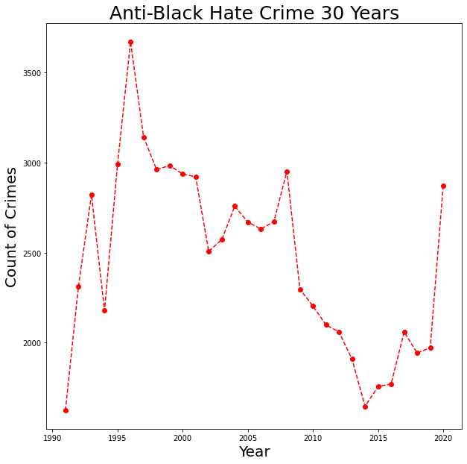
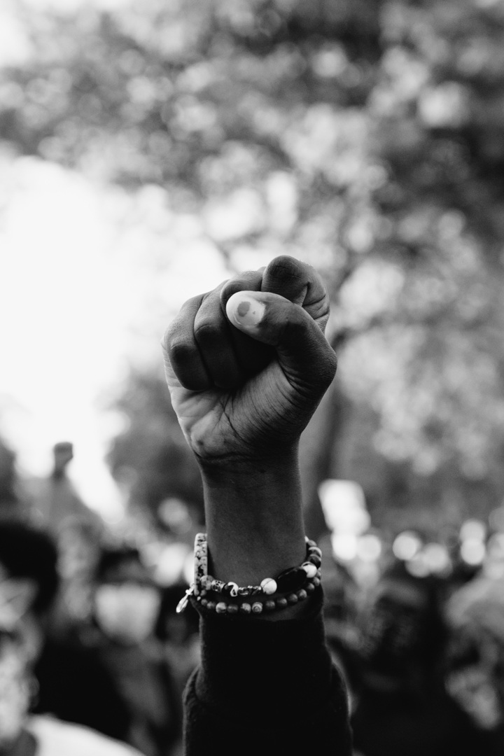





“We black men have a hard enough time in our own struggle for justice.”
-Malcom X

Slide 8
Factors that Influence the Spike (Anti-Black)
Overall increase between: 1990-1995
1991-1993: “tough on crime” policies—almost impossible for candidates to run for office and appear soft on crime. “Tough on crime” was essentially code for imprisonment of black men.
Public opinion: fear
Push for crime bill of 1994
“Super Predator”
Central park 5 jogger case: Massive public pressure to lock them up
Resource: 13th documentary (Netflix)

Slide 9
Factors that Influence the Spike (Anti-Black)
56% of race-based hate crimes being motivated by anti-Black bias.
Overall increase between: 2014-2020
Trump’s campaign and presidency: 2015-2016 & 2017-2020
May have encouraged people to express their intolerance towards black Americans.
Spike in 2020—46% increase
A rise in hate crimes for a group that has already been the most victimized
2020 Protests due to police brutality

